Slide 1
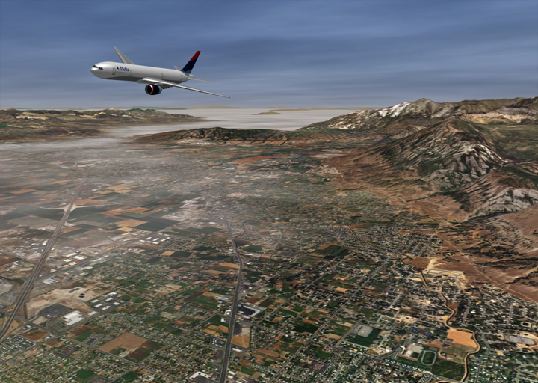
Texture Mapping
Beautification of Surfaces

Slide 2
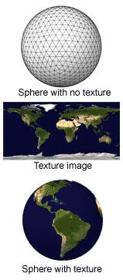
Texture Mapping Overview (1/3)
Texture mapping:
Implemented in hardware on every GPU
Simplest surface detail hack, dating back to the ‘60s GE flight simulator and its terrain generator
Technique:
“Paste” photograph or bitmap (the texture, for example: a brick pattern, a wood grain pattern, a sky with clouds) on a surface to add detail without adding more polygons.
Map texture onto the surface, get the surface color or alter the object’s surface color
Think of texture map as stretchable contact paper

Slide 3
Texture Mapping Overview (2/3: Motivation)
How do we add more detail to a model?
Add more detailed geometry; more, smaller triangles:
Pros: Responds realistically to lighting, other surface interaction
Cons: Difficult to generate, takes longer to render, takes more memory space
Map a texture to a model:
Pros: Can be stored once and reused, easily compressed to reduce size, rendered very quickly, very intuitive to use, especially useful on far-away objects, terrain, sky,…
Cons: Very crude approximation of real life. Texture mapped but otherwise unaltered surfaces still look smooth.
What can you put in a texture map?
Diffuse, ambient, specular, or any kind of color
Specular exponents, transparency or reflectivity coefficients
Surface normal data (for normal mapping or bump mapping)
Projected reflections or shadows

Slide 4
Texture Mapping Overview (3/3: Mappings)
A function is a mapping
Takes any value in the domain as an input and outputs (“maps it to”) one unique value in the co-domain.
Mappings in “Intersect”: linear transformations with matrices
Map screen space points (input) to camera space rays (output)
Map camera space rays into world space rays
Map world space rays into un-transformed object space for intersecting
Map intersection point normals to world space for lighting
Mapping a texture:
Take points on the surface of an object (domain)
Return an entry in the texture (co-domain)

Slide 5
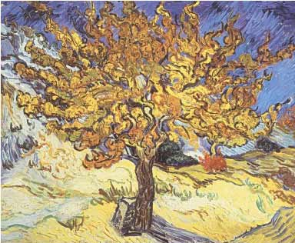
Texture Mapping Technique (1/8)
Texture mapping is the process of mapping a geometric point in space to a value (color, normal, other…) in a texture map of arbitrary width and height
Our goal is to map any arbitrary geometry to a texture map
This is done in two steps:
Map a point on the geometry to a point on the unit square (a proxy for the texture map)
Map the unit square point to point on the texture
Second mapping is much easier, we’ll present it first.
(1.0, 1.0)
$$v$$
(0.0, 0.0)
$$u$$
Van Gogh

Slide 6
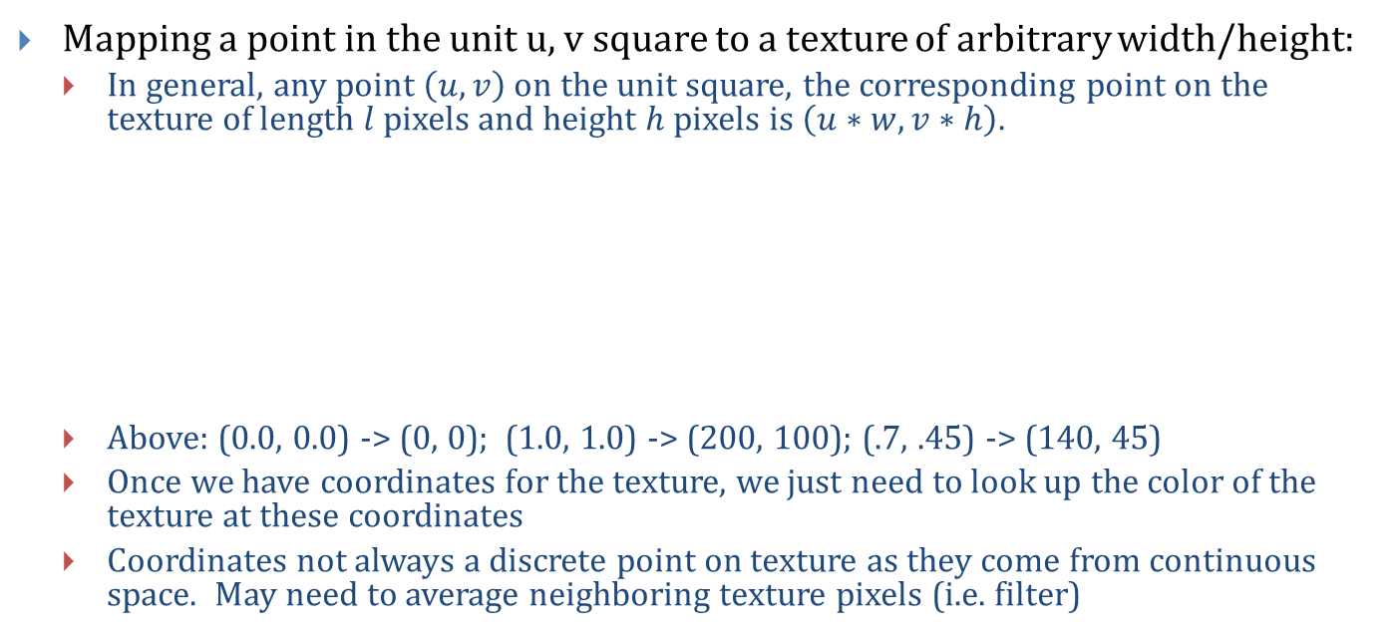
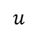
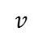
Texture Mapping Technique (2/8)
Mapping a point in the unit u, v square to a texture of arbitrary width/height:
In general, any point $\left(u, v\right)$ on the unit square, the corresponding point on the texture of length $l$ pixels and height $h$pixels is $\left(u∗w, v∗h\right)$.
Above: (0.0, 0.0) -> (0, 0); (1.0, 1.0) -> (200, 100); (.7, .45) -> (140, 45)
Once we have coordinates for the texture, we just need to look up the color of the texture at these coordinates
Coordinates not always a discrete point on texture as they come from continuous space. May need to average neighboring texture pixels (i.e. filter)
$$v$$
(1.0, 1.0)
(200, 100)
unit texture square
(0, 0)
(0.0, 0.0)
texture map
$$u$$

Slide 7
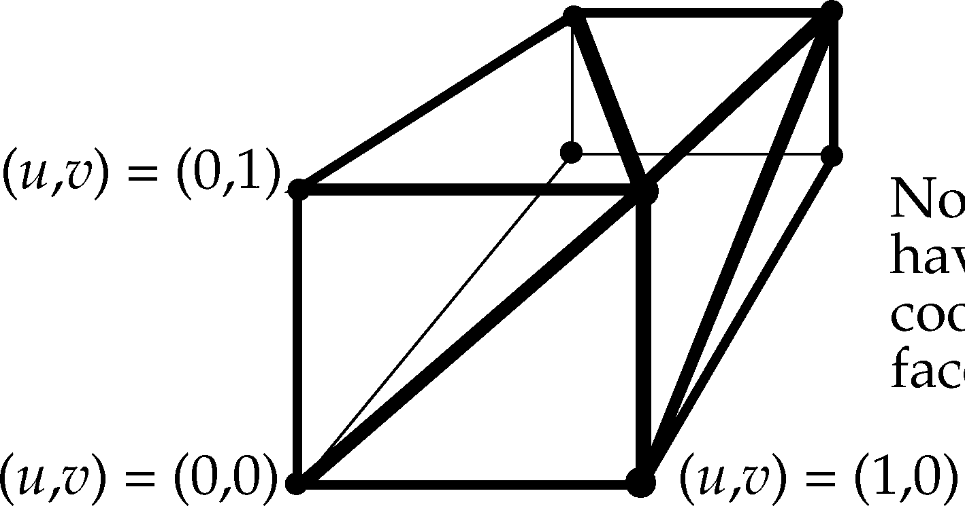
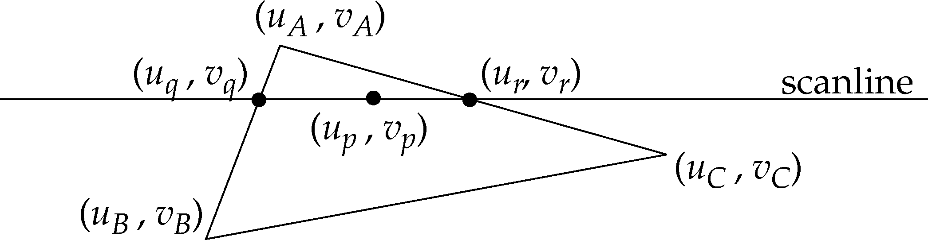
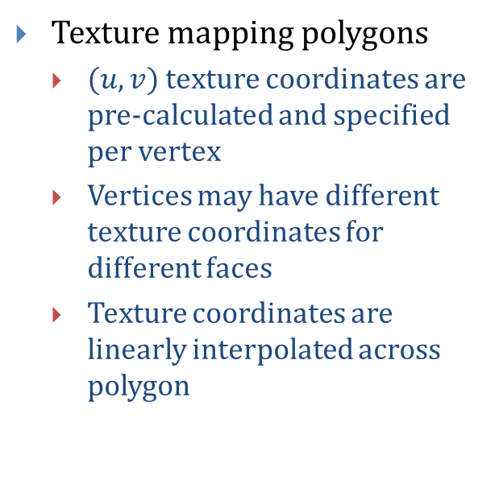
Texture Mapping Technique (3/8)
Texture mapping polygons
$(u, v)$ texture coordinates are pre-calculated and specified per vertex
Vertices may have different texture coordinates for different faces
Texture coordinates are linearly interpolated across polygon

Slide 8
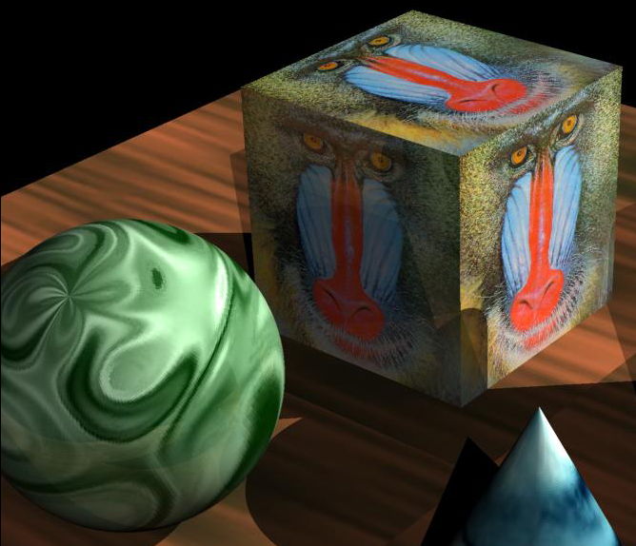
Texture Mapping Technique (4/8): mapping from point on object to (u, v) square
Texture mapping in “Ray”: mapping solids
Using ray tracing, get an intersection point (x, y, z) in object space
Need to map this point to a point on the (u, v) unit square, so we can map that to a texture value
Three easy cases: planes, cylinders, and spheres
Easiest to compute the mapping from (x, y, z) coordinates in object space to (u, v)
Can cause unwanted texture scaling
Texture filtering is an option in most graphics libraries
OpenGL allows you to choose filtering method. (GL_NEAREST, GL_LINEAR, etc…)

Slide 9
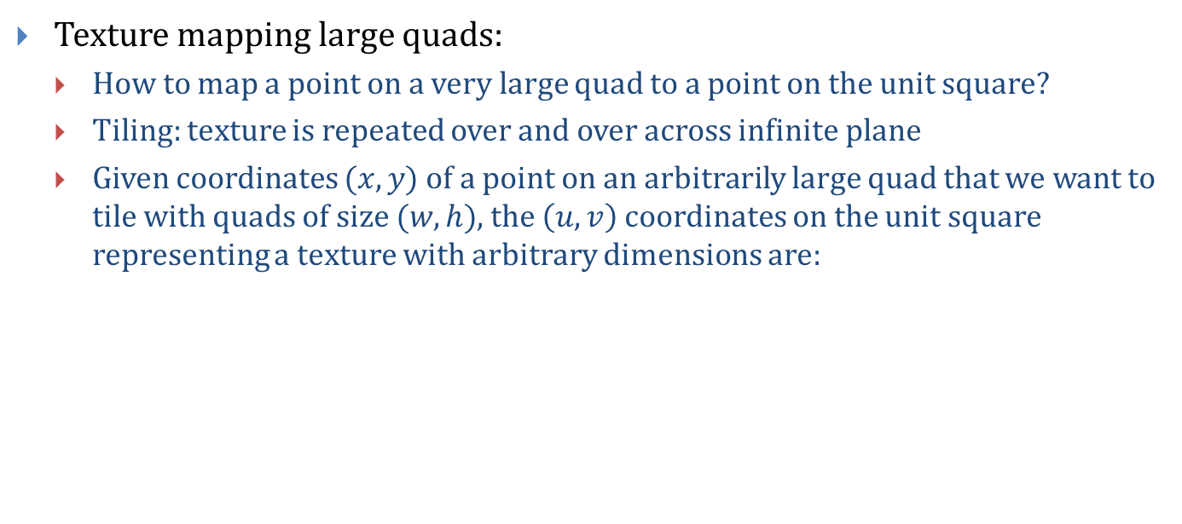
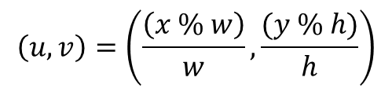
Texture Mapping Technique (5/8)
Texture mapping large quads:
How to map a point on a very large quad to a point on the unit square?
Tiling: texture is repeated over and over across infinite plane
Given coordinates $(x, y)$ of a point on an arbitrarily large quad that we want to tile with quads of size $(w,h)$, the $\left(u, v\right)$ coordinates on the unit square representing a texture with arbitrary dimensions are:
-z
(1.0, 1.0)
v
(w, h)
$$\left(u, v\right)=\left(\frac{\left(x \% w\right)}{w},\frac{(y \% h)}{h}\right)$$
(0, 0)
(0, 0)
u
Note: C/C++ do not allow non-integer moduli.
In code, w and h must be integers.
x
Unit plane
Infinite plane

Slide 10
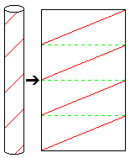
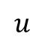
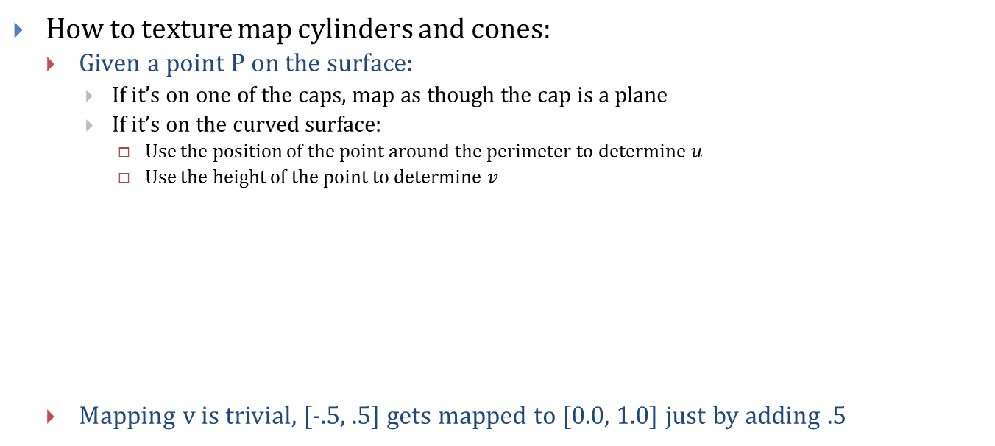
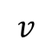
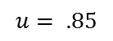
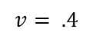
Texture Mapping Technique (6/8)
How to texture map cylinders and cones:
Given a point P on the surface:
If it’s on one of the caps, map as though the cap is a plane
If it’s on the curved surface:
Use the position of the point around the perimeter to determine $u$
Use the height of the point to determine $v$
Mapping v is trivial, [-.5, .5] gets mapped to [0.0, 1.0] just by adding .5
$$v$$
$$u$$
z
y
x
P
x
P
$$v= .4$$
$$u= .85$$
z
http://www.syvum.com/iosundry/teasers/cylind1b.gif

Slide 11
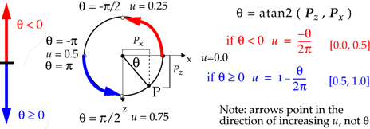
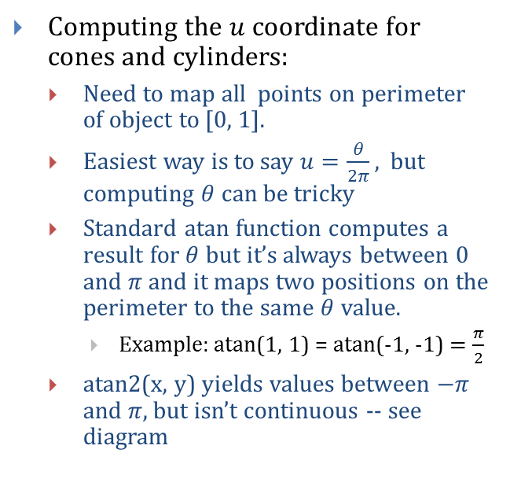
Texture Mapping Technique (7/8)
Computing the $u$ coordinate for cones and cylinders:
Need to map all points on perimeter of object to [0, 1].
Easiest way is to say $u=\frac{θ}{2π}$, but computing $θ$ can be tricky
Standard atan function computes a result for $θ$ but it’s always between 0 and $π$ and it maps two positions on the perimeter to the same $θ$ value.
Example: atan(1, 1) = atan(-1, -1) $=\frac{π}{2}$
atan2(x, y) yields values between $−π$ and $π$, but isn’t continuous -- see diagram

Slide 12
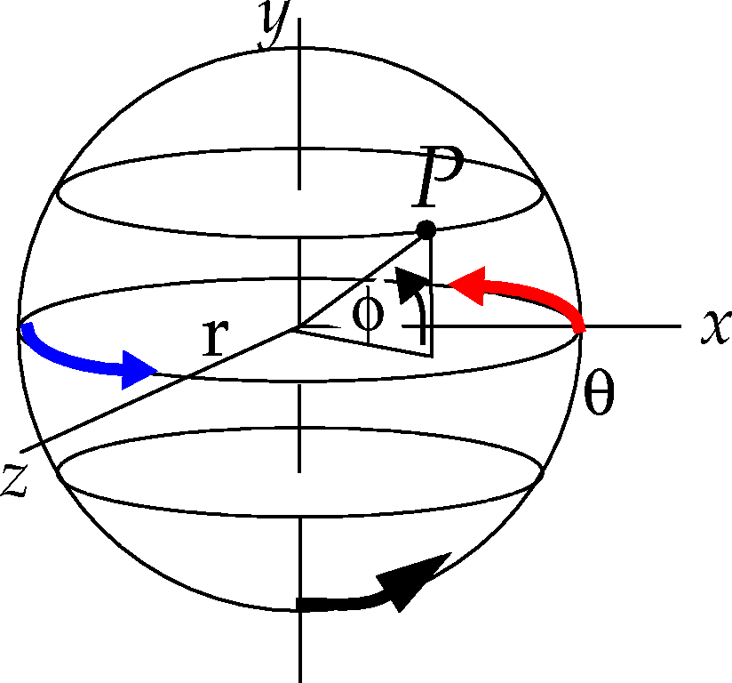
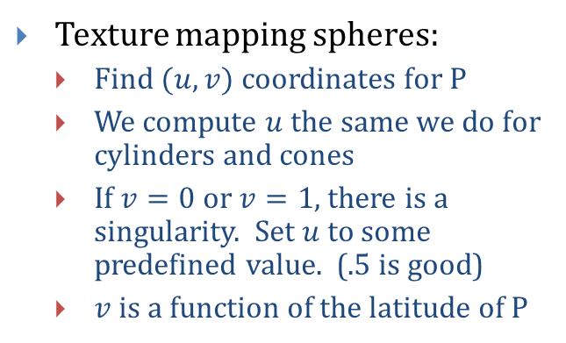
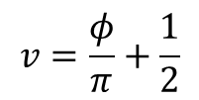
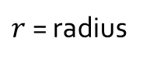
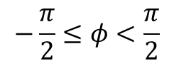
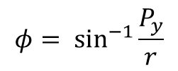
Texture Mapping Technique (8/8)
Texture mapping spheres:
Find $(u, v)$ coordinates for P
We compute $u$ the same we do for cylinders and cones
If $v=0$ or $v=1$, there is a singularity. Set $u$ to some predefined value. (.5 is good)
$v$is a function of the latitude of P
$$φ= \sin^{−1}{\frac{P_{y}}{r}}$$
$$−\frac{π}{2}≤φ<\frac{π}{2}$$
$r$ = radius
$$v=\frac{φ}{π}+\frac{1}{2}$$

Slide 13
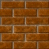
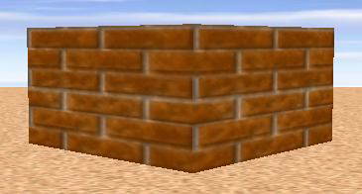
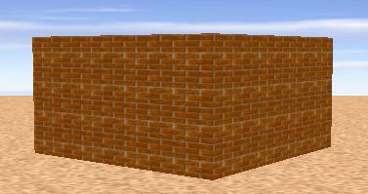
Texture Mapping Style - Tiling
We want to create a brick wall with a brick pattern texture
A brick pattern is very repetitive, we can use a small texture and “tile” it across the wall
Without Tiling
Texture
Tiling allows you to scale repetitive textures to make texture elements just the right size.
With Tiling

Slide 14
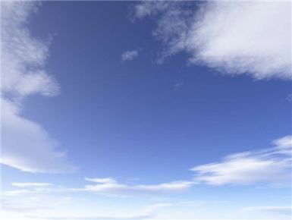
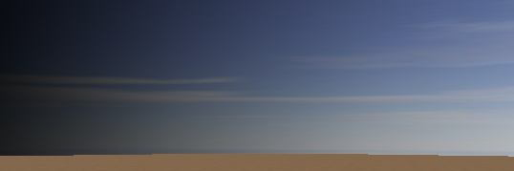
Texture Mapping Style - Stretching
With non-repetitive textures, we have less flexibility
Have to fill an arbitrarily large object with a texture of finite size
Can’t tile (will be noticeable), have to stretch instead
Example, creating a sky backdrop:
Applied with stretching
Texture

Slide 15
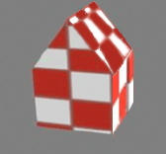
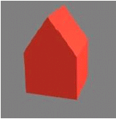
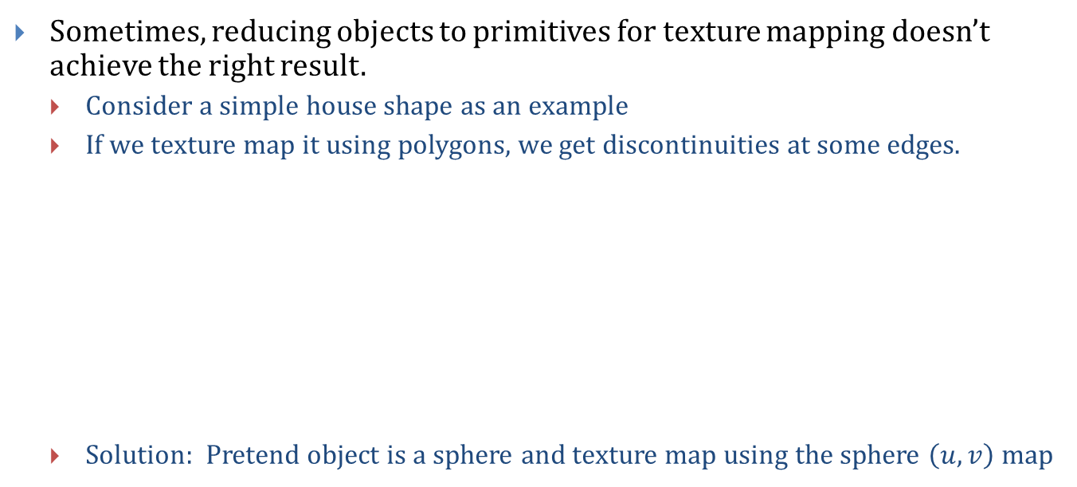
Texture Mapping Complex Geometry (1/4)
Sometimes, reducing objects to primitives for texture mapping doesn’t achieve the right result.
Consider a simple house shape as an example
If we texture map it using polygons, we get discontinuities at some edges.
Solution: Pretend object is a sphere and texture map using the sphere $\left(u, v\right)$ map

Slide 16
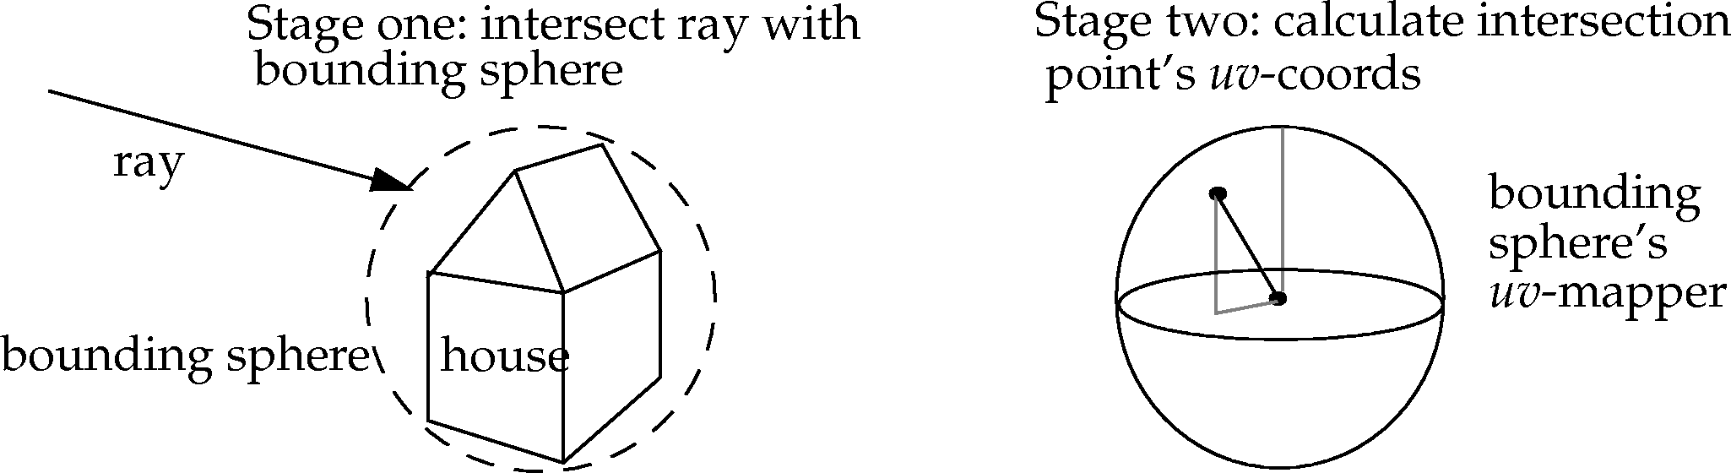
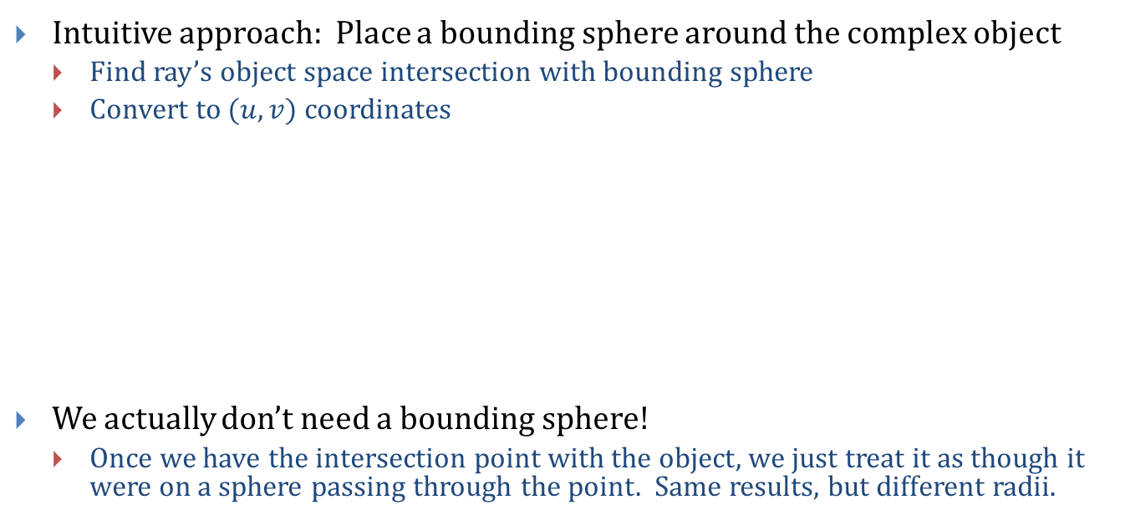
Texture Mapping Complex Geometry (2/4)
Intuitive approach: Place a bounding sphere around the complex object
Find ray’s object space intersection with bounding sphere
Convert to $(u, v)$ coordinates
We actually don’t need a bounding sphere!
Once we have the intersection point with the object, we just treat it as though it were on a sphere passing through the point. Same results, but different radii.

Slide 17
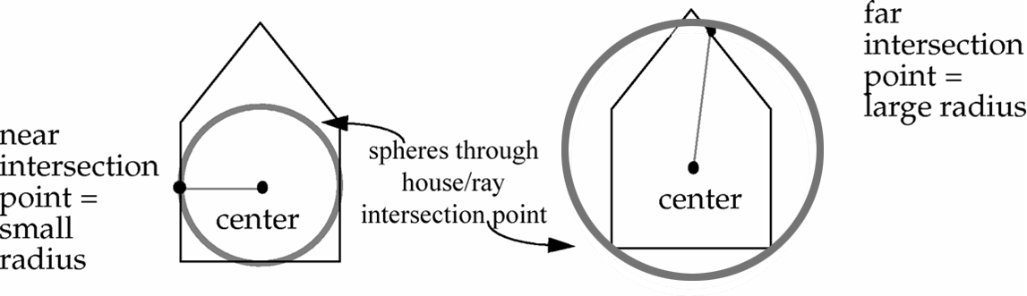
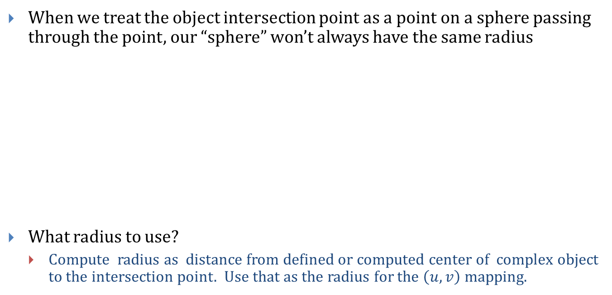
Texture Mapping Complex Geometry (3/4)
When we treat the object intersection point as a point on a sphere passing through the point, our “sphere” won’t always have the same radius
What radius to use?
Compute radius as distance from defined or computed center of complex object to the intersection point. Use that as the radius for the $\left(u, v\right)$ mapping.

Slide 18
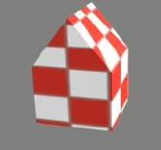
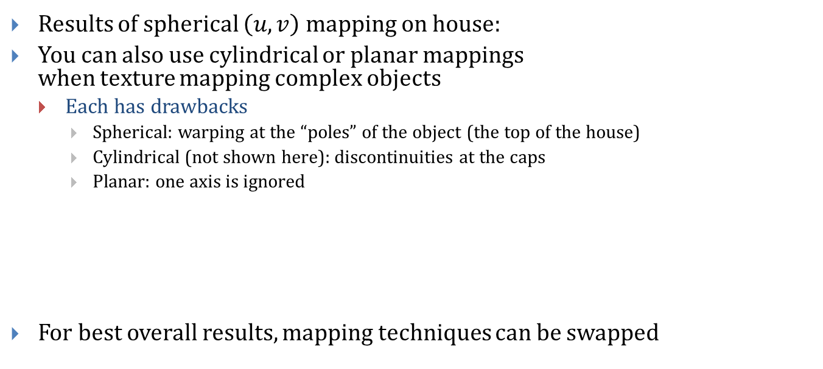
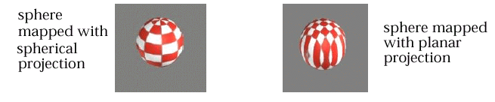
Texture Mapping Complex Geometry (4/4)
Results of spherical $\left(u, v\right)$ mapping on house:
You can also use cylindrical or planar mappings when texture mapping complex objects
Each has drawbacks
Spherical: warping at the “poles” of the object (the top of the house)
Cylindrical (not shown here): discontinuities at the caps
Planar: one axis is ignored
For best overall results, mapping techniques can be swapped

Slide 19
Aside: Barycentric Coordinates
Say we have a triangle mesh
And we’ve defined colors at the vertices of the triangles
How do we define the colors of the pixels that are on the interior or edges of the triangle?
Interpolating colors in the triangle is made easier by using Barycentric coordinates
We can define a point on a triangle in terms of its 3 vertices
Then use the new representation to choose an appropriate color
Many applications
Mesh Colors (painting textures on to arbitrary meshes):
Cem Yuksel, John Keyser, and Donald H. House Mesh Colors ACM Transactions on Graphics (TOG), Vol. 29, No. 2, 2010
Take CS224
?

Slide 20
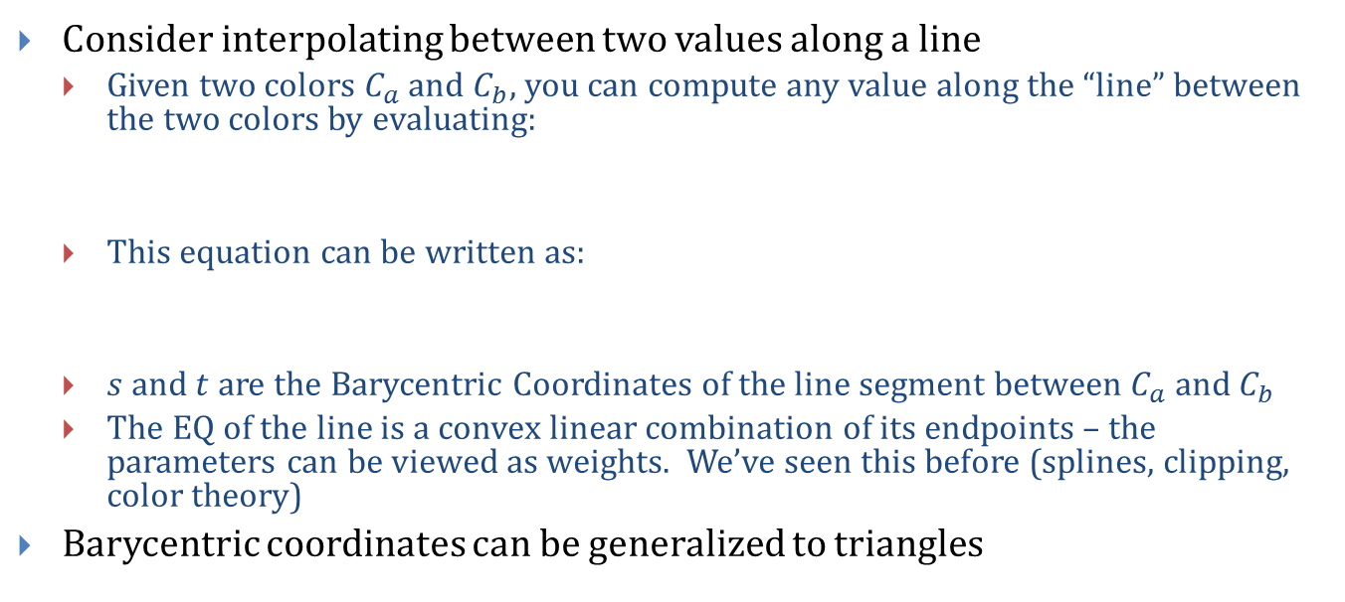
Interpolation Tricks: Barycentric Coordinates
Consider interpolating between two values along a line
Given two colors $C_{a}$ and $C_{b}$, you can compute any value along the “line” between the two colors by evaluating:
This equation can be written as:
$s$ and $t$ are the Barycentric Coordinates of the line segment between $C_{a}$ and $C_{b}$
The EQ of the line is a convex linear combination of its endpoints – the parameters can be viewed as weights. We’ve seen this before (splines, clipping, color theory)
Barycentric coordinates can be generalized to triangles
$$C\left(t\right)= \left(1−t\right)C_{a}+{tC}_{b} 0≤t≤1$$
$$C\left(s, t\right)=sC_{a}+{tC}_{b} s+t=1 s, t≥0$$
$$C\left(s, t, u\right)=sC_{a}+{tC}_{b}+uC_{c} s+t+u=1 s, t, u≥0$$

Slide 21
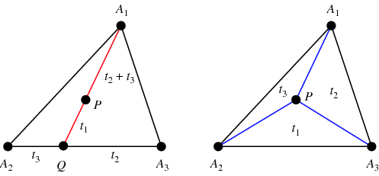
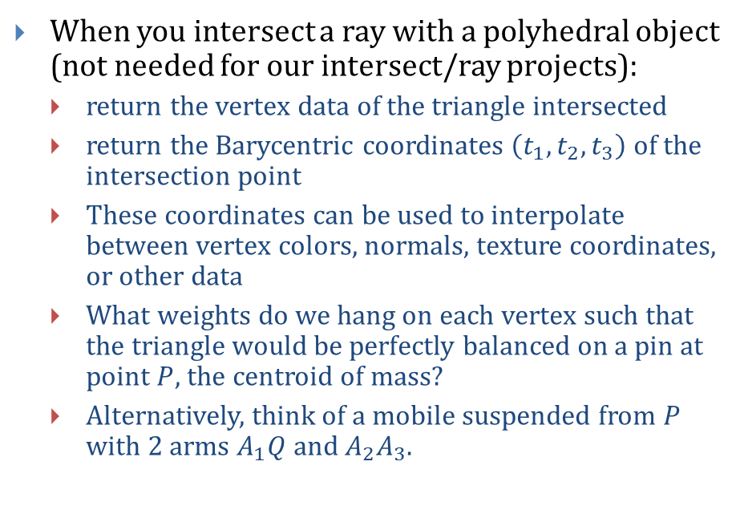
Applying Barycentric Coordinates (1/2)
When you intersect a ray with a polyhedral object (not needed for our intersect/ray projects):
return the vertex data of the triangle intersected
return the Barycentric coordinates $\left(t_{1}, t_{2}, t_{3}\right)$ of the intersection point
These coordinates can be used to interpolate between vertex colors, normals, texture coordinates, or other data
What weights do we hang on each vertex such that the triangle would be perfectly balanced on a pin at point $P$, the centroid of mass?
Alternatively, think of a mobile suspended from $P$ with 2 arms $A_{1}Q$and $A_{2}A_{3}$.
http://mathworld.wolfram.com/images/eps-gif/Barycentric_901.gif

Slide 22
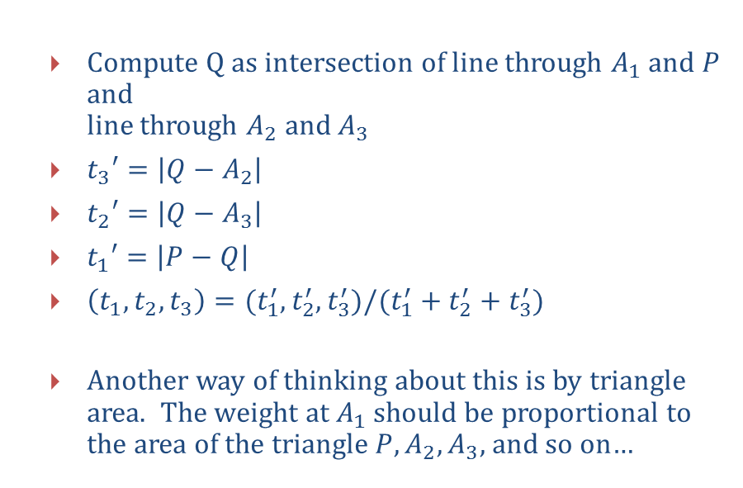
Applying Barycentric Coordinates (2/2)
Compute Q as intersection of line through $A_{1}$ and $P$ and line through $A_{2}$ and $A_{3}$
$t_{3}′=\left|Q−A_{2}\right|$
$t_{2}′=\left|Q−A_{3}\right|$
$t_{1}′=\left|P−Q\right|$
$\left(t_{1},t_{2},t_{3}\right)=(t_{1}^{′},t_{2}^{′}, t_{3}^{′})/(t_{1}^{′}+t_{2}^{′}+t_{3}^{′})$
Another way of thinking about this is by triangle area. The weight at $A_{1}$ should be proportional to the area of the triangle $P,A_{2},A_{3}$, and so on…
http://mathworld.wolfram.com/images/eps-gif/Barycentric_901.gif

